Slide 1



[WRO] #5 Workshop Microsoft Azure User Group Poland we Wrocławiu
Michał Jankowski / Piotr Rogala

Slide 2



Slide 3
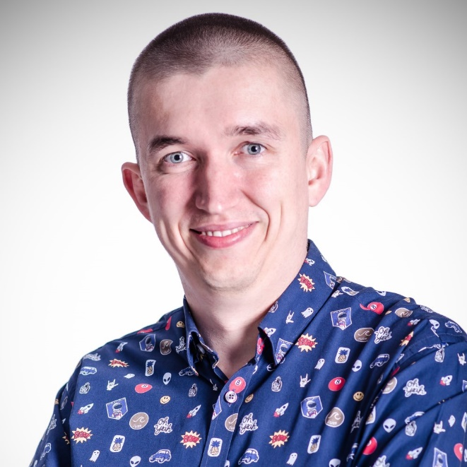


about me
⇩ | architect / software developer / team leader
 | traveller / photographer
✶ | www.jankowskimichal.pl
→ | mail@jankowskimichal.pl
 | @JankowskiMichal
 | github.com/MichalJankowskii
Michał Jankowski

Slide 4
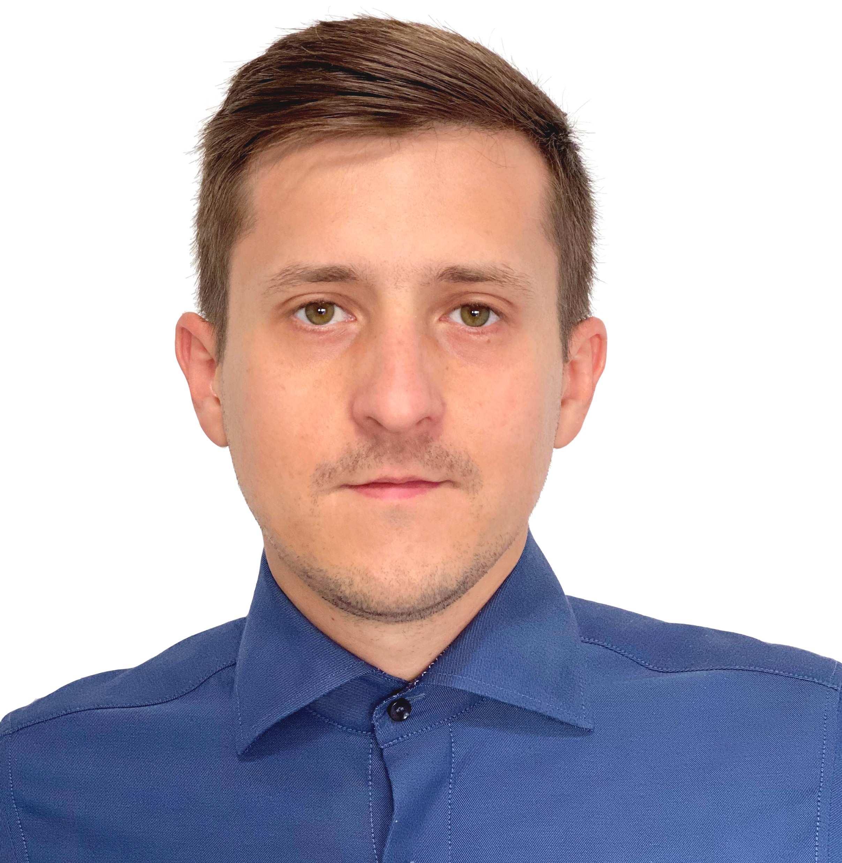




About Me
Currently working in
Azure Cloud Architect Lead
MVP Azure
Blog:
Group leader:
@RogalaPiotr
linkedin.com/in/rogalapiotr

Slide 5

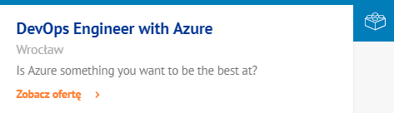
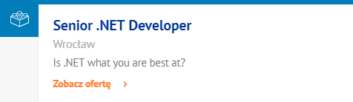
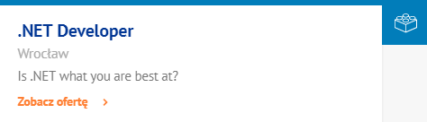
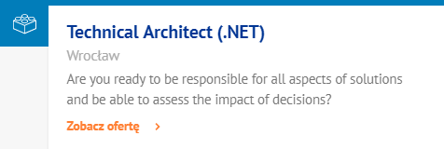
joinus.objectivity.co.uk/

Slide 6
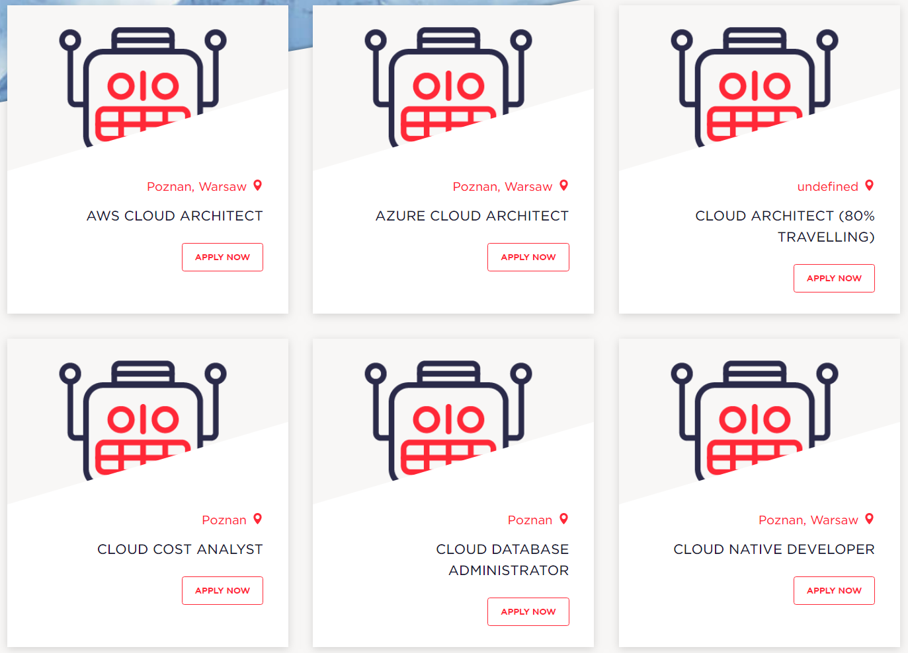
https://nordcloud.com/open-positions/?country-positions=poland (15)

Slide 7
#6 Workshop Microsoft Azure User Group Poland we Wrocławiu
15.02.2020
Gdzie: Softserve
Topic: DevOps
Kto: Piotr Rogala & Jakub Podoba

Slide 8
[WRO] 18 spotkanie Microsoft Azure User Group Poland
05.02.2020
Topic 1: Scales Set
Topic 2: TBD
Gdzie: Mleczarnia

Slide 9
